Slide 1
TastyBites — Product Pricing & Profitability Report
Generated: 2025-11-27 07:17
Dataset: tastybites_orders.csv (synthetic)

Slide 2
Executive Summary
Total Revenue: ₹4,383,720.30
Total Profit: ₹1,775,798.97
Average Order Value (AOV): ₹797.04
  Key findings:
  - Top products drive majority of revenue, but some high-volume items have low margins.
  - Discounts reduce profit noticeably beyond 10%.

Slide 3
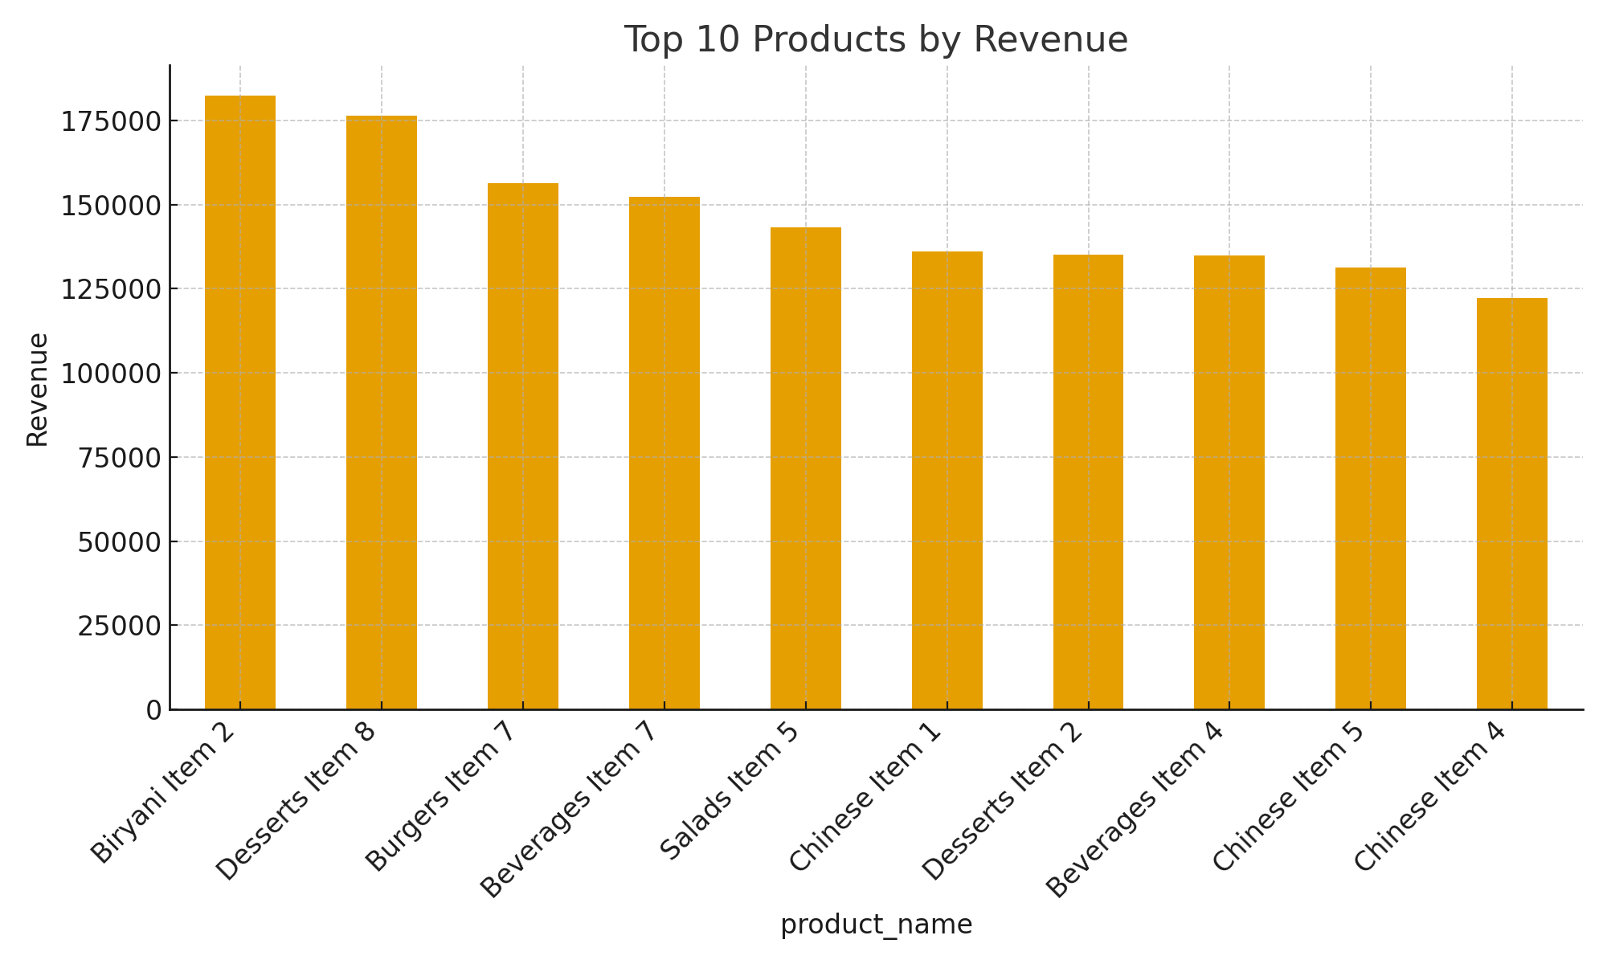
Top 10 Products by Revenue

Slide 4
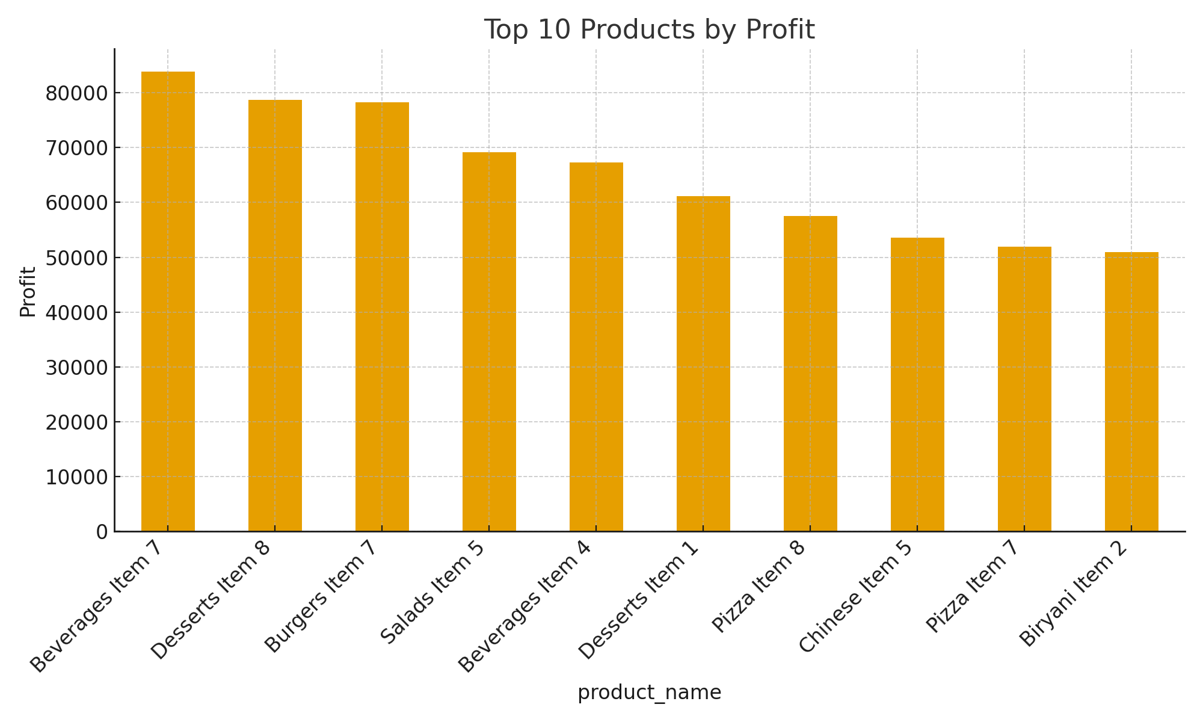
Top 10 Products by Profit

Slide 5
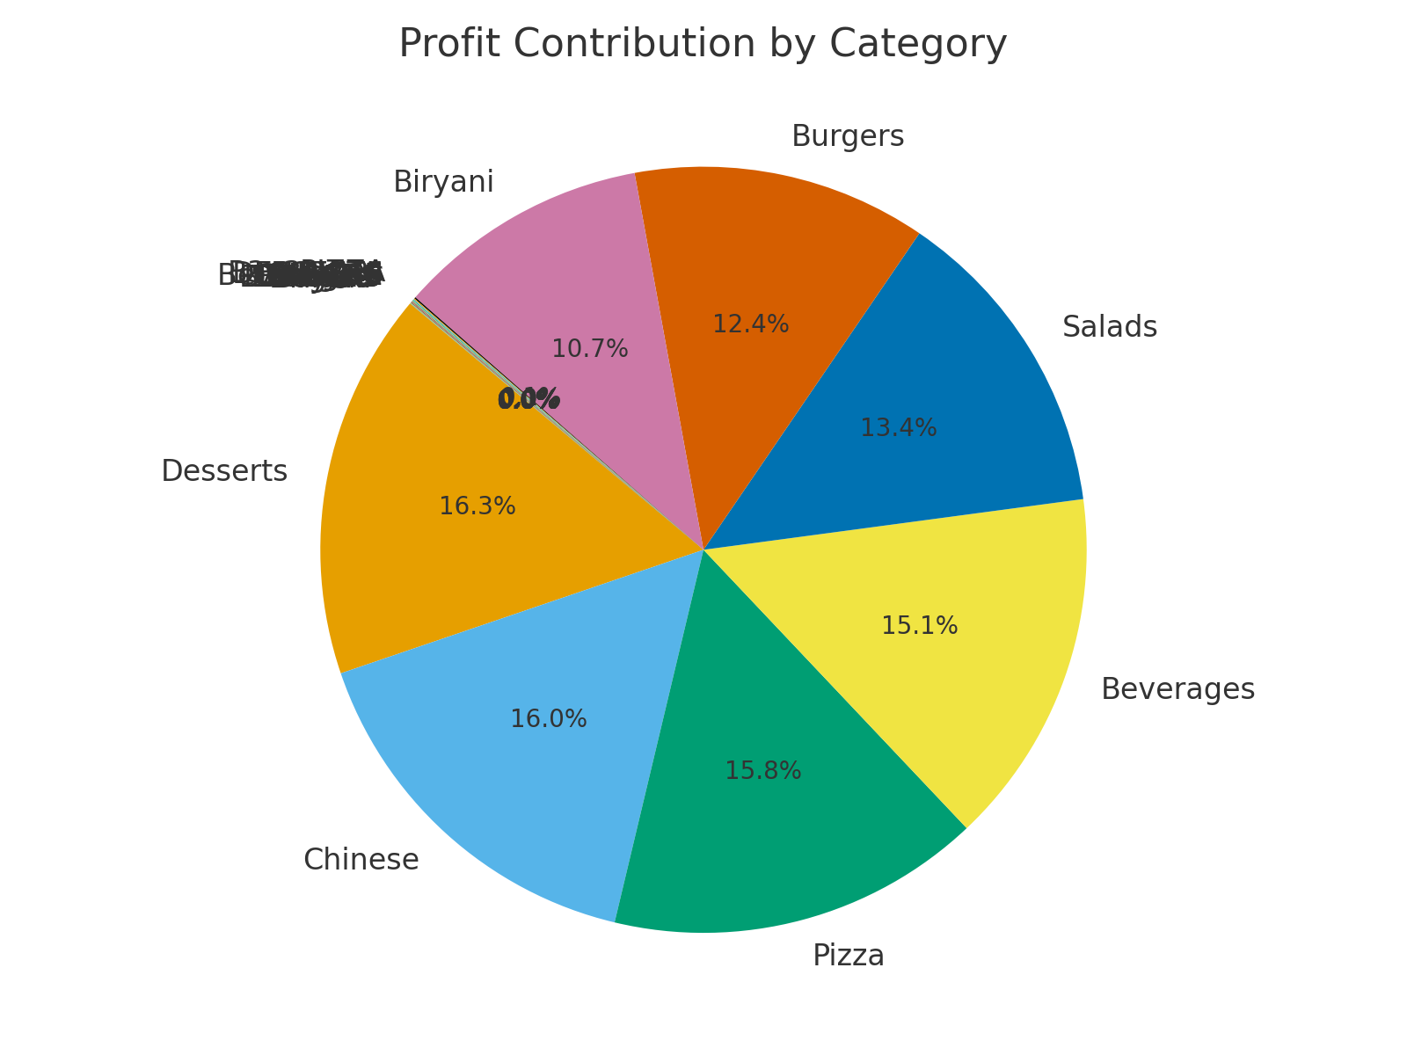
Profit Contribution by Category

Slide 6
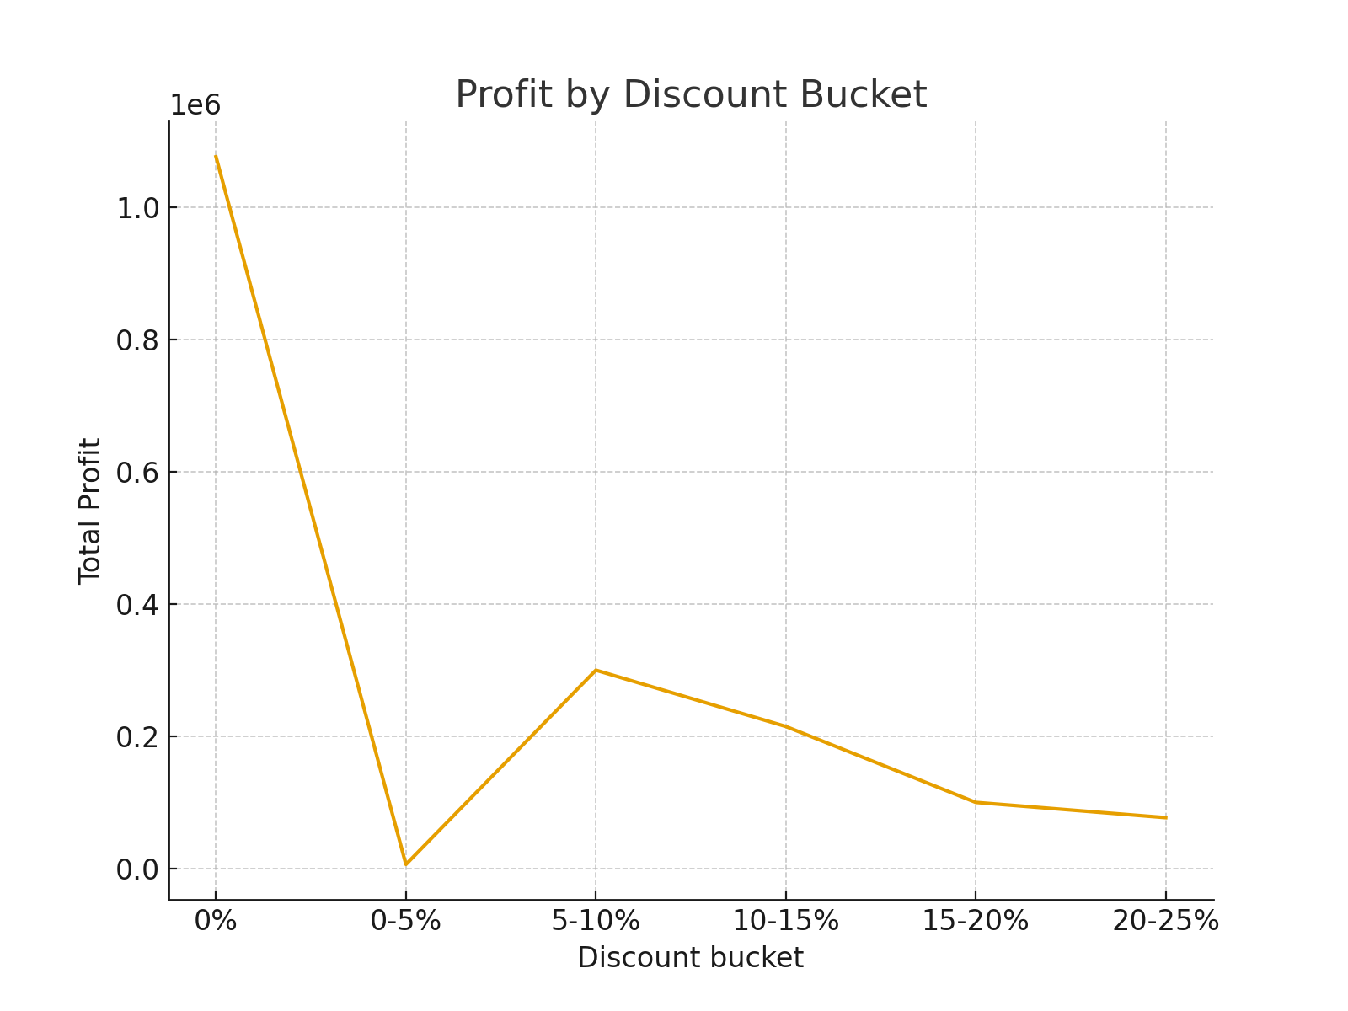
Impact of Discounts on Profit

Slide 7
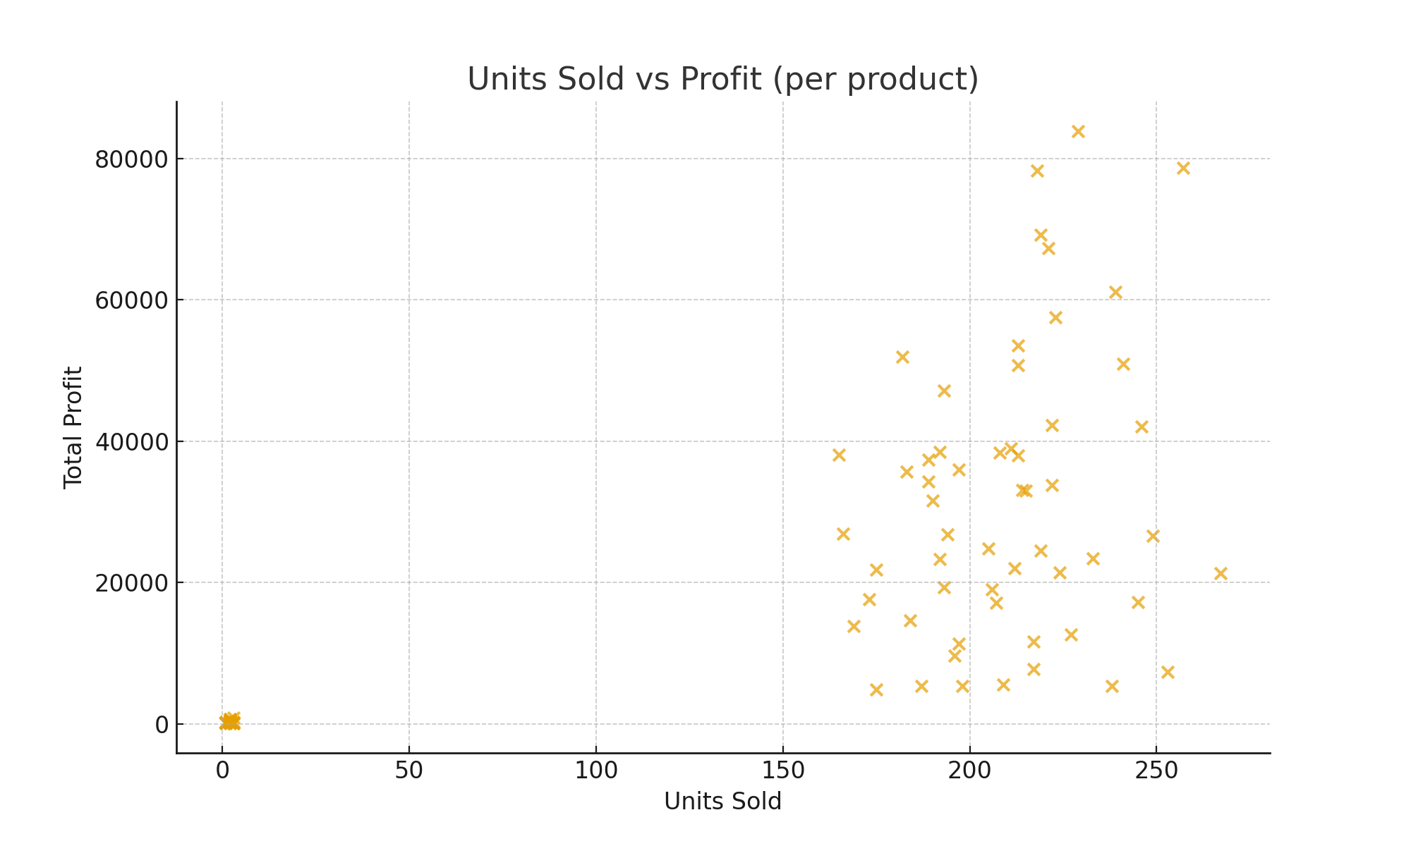
Units Sold vs Profit (per product)

Slide 8
Recommendations
Quick wins:
  - Promote high-margin, high-contribution items via banners & free delivery.
  - Reduce discount depth on low-margin bestsellers (keep ≤5%).
  - Introduce bundling: pair low-margin bestsellers with high-margin sides.
Long-term strategies:
  - Price optimization experiments (A/B test ≤10% changes).
  - Rework menu costs or portioning on low-margin, high-volume items.

